Slide 1
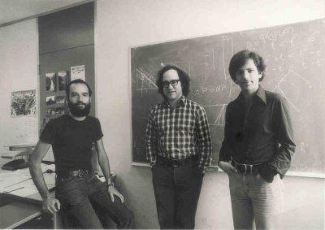
RSA (Rivest Shamir Adleman)
-1978
In 2002, the Association for Computing Machinery awarded Rivest, Shamir, and Adleman the Turing Award - also known as the "Nobel Prize of Computing."
Notes:
In 2002, the Association for Computing Machinery awarded Rivest, Shamir, and Adleman the Turing Award - also known as the "Nobel Prize of Computing."

Slide 2
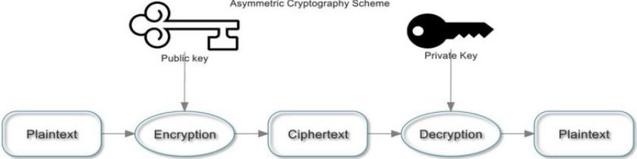
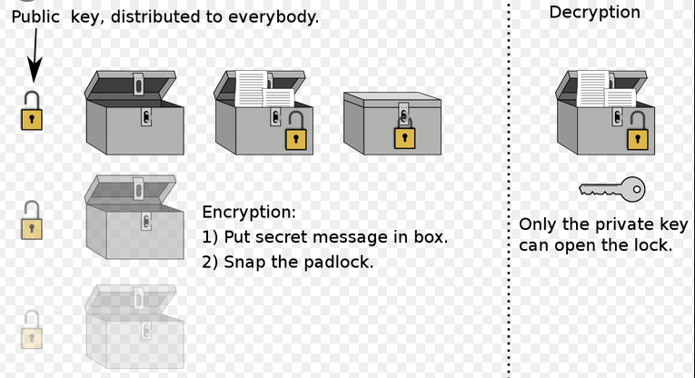
Asymmetric Encryption

Slide 3
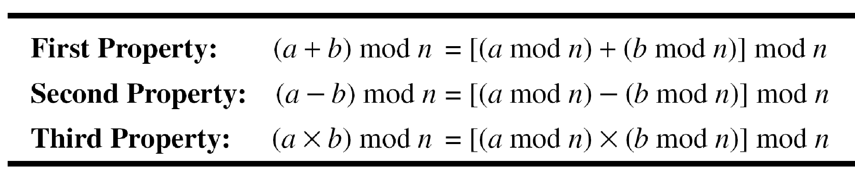
Modulus Operations
Add 17 to 27 in Z₁₄
Subtract 43 from 12 in Z₁₃
Multiply 123 by −10 in Z₁₉
14+7 mod 15
7-11 mod 13
7 x 11 mod 20
3
Notes:
3
Mod with negative numbers:
Dividing −18 by 14 results in r = −4. After adding the modulus r = 10
Dividing −7 by 10 results in r = −7. After adding the modulus to −7, r = 3
Exercise
-8 mod 10
-7 mod 13
-13 mod 5
-18 mod 14

Slide 4


Inverses
Two numbers a and b are additive inverses of each other if
Find additive inverse
  4 mod 13, 7 mod 17
Two numbers a and b are mutliplicative inverses of each other if
Find multiplicative inverse
  3 mod 5, 2 mod 7
4
Notes:
4

Slide 5
Euler’s Totient Function
Relatively Prime: When two numbers have no common factors other than 1
Euler’s Totient Function: Euler's totient function counts the positive integers up to a given integer n that are relatively prime to n.
Notes:
Relatively Prime: When two numbers have no common factors other than 1
Euler’s Totient Function: Euler's totient function counts the positive integers up to a given integer n that are relatively prime to n.

Slide 6
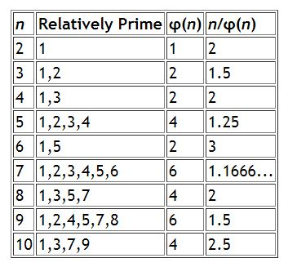
Euler’s Totient Function

Slide 7
Euler’s Totient Function
Euler’s Totient φ(p) = (p-1)
Euler’s Totient φ(q) = (q-1)
where p and q are both prime
Euler’s Totient φ(n) = (p-1)(q-1)
where p!=q

Slide 8
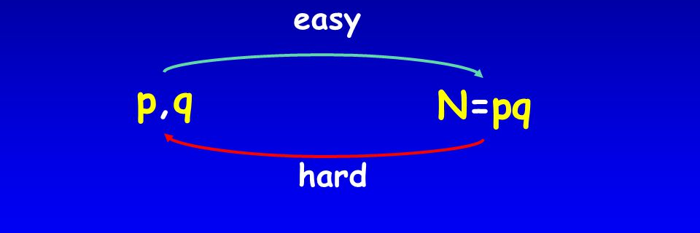
Trapdoor Function
a trapdoor function is a function that is easy to compute in one direction, yet difficult to compute in the opposite direction
factoring product of 2 large primes

Slide 9
Encryption and Decryption
p=3, q=11, n=33
M = 2
C = 2⁷ % 33 = 29
D = 29³ % 33 = 2
Parameters
Encryption: Plaintext M<n
Ciphertext C= Me(mod n)
Decryption:
  D= (Me)^{d} mod n = M mod n
As d and e are inverse to each other so we get M

Slide 10
Key Generation
Euler’s Totient, φ(n) = (p-1)(q-1)
Euler’s Theorem, d*e = 1 mod φ(n)
Choose e such that 1 < e < φ(n) and e and φ (n) are coprime.
Public key is (e, n)
Private key is (d, p, q)
φ(n) = 2 * 10 = 20
Let e = 7
[(3 * 7) % 20 = 1]
Public key =(7, 33)
Private key = (3, 33)

Slide 11
Security of RSA
  The problem of factoring n into two prime factors is computationally very difficult
  Because n = p * q where p and q are at least 600 digit numbers(2048 bit), product is even bigger.
  φ(n) cannot be computed without factoring n
  As φ(n) is not known e and d are not known either.
  Cipher remains unbreakable
Notes:
11

Slide 12
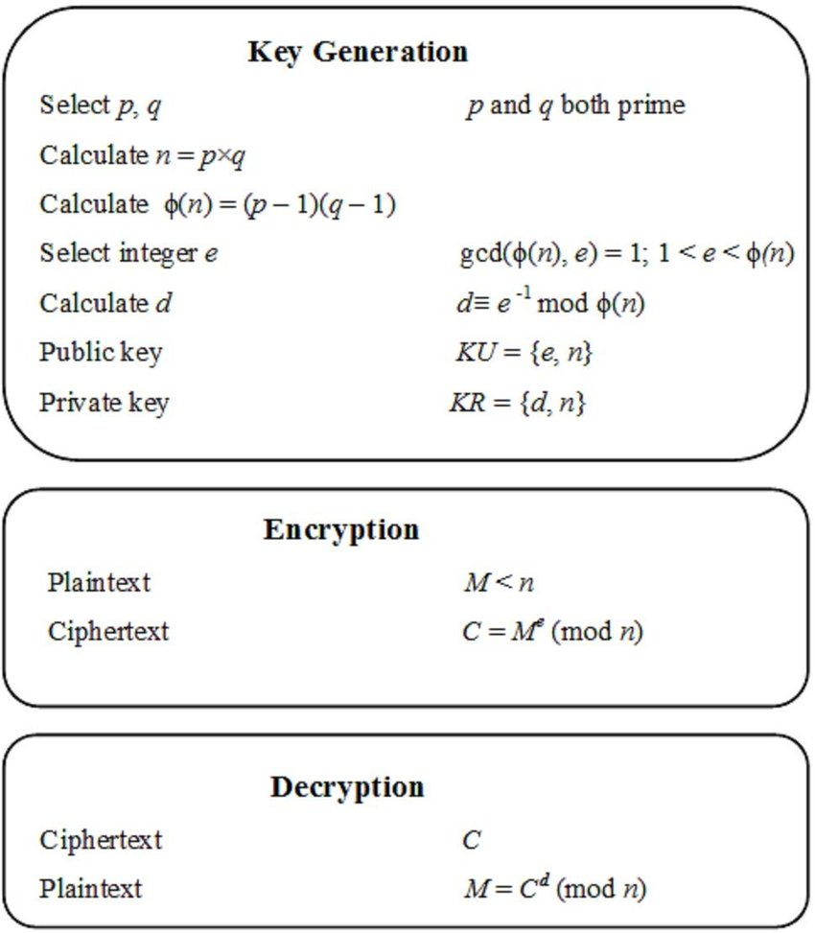
So Far
Simplifications so far:
Message
Calculating d
Encryption/Decryption

Slide 13
Message Preprocessing
Each letter in the message is represented as its ASCII code number.
In ASCII, 'A' is coded as 65, 'B' is coded as 66 and so on.
The message "Secret!" is coded as: 83 101 99 114 101 116 33
Each ASCII code number is then represented in binary notation using 8 bits.
  01010011 01100101 01100011 01110010 01100101 01110100 00100001
Notes:
13

Slide 14
Message Preprocessing
Each pair of characters is then assembled into blocks (may be 8 or 16 characters)
In this example, there are 7 original characters that form 4 blocks (with padding):
  01010011 01100101 , 01100011 01110010
  01100101 01110100 , 00000000 00100001
Each message block is then represented as a decimal number that will be encrypted.
For this example, the code blocks in decimal are:
21349, 25458, 25972, 33
Notes:
14
Real applications of RSA use blocks of up to 8 or 16 characters each (64 or 128 bits in length).

Slide 15
RSA Algorithm
21349
25458
25972
33
Block Cipher:
Encryption: Plaintext M<n
Ciphertext C= Me(mod n)
Decryption: D= (Me)^{d} mod n = Mde mod n = M mod n
  As d and e are inverse to each other so we get M
M<n
Notes:
15

Slide 16
Calculating d: Extended Eucledian Algorithm
Inverse of 5 in mod 7
7 = 1.5+2 -> 7-1.5=2
5=2.2+1 ->5-2.2=1
5-2.2=1 , putting the value of 2 we get
5-2(7-1.5)=1
5-2.7+2.5=1
3.5-2.7=1 mod 7 -> 3 is the multiplicative inverse
Notes:
16

Slide 17
Calculating d: Extended Eucledian Algorithm
Inverse of 3 in mod 11
11=3.3+2 -> 11-3.3=2
3=1.2+1 -> 3-1.2=1
3-1.2=1, putting value of 2
3-1(11-3.3)=1
3-1.11+3.3=1
-1.11+4.3=1 mod 11 -> 4 is the multiplicative inverse

Slide 18
Fast Exponentiation
a = bc mod n = (b mod n).(c mod n) mod n
Note that any number can be expressed as a sum of powers of 2.
C = 13⁷ mod 33
    = 13⁽⁴⁺²⁺¹⁾ mod 33
    = 13⁴.13².13¹ mod 33
    = (13⁴ mod 33)(13²mod 33)(13¹ mod 33)
    = (13²mod 33) )(13²mod 33) .4 .13 mod 33
    = 4.4.4.13 mod 13
    = 7 mod 33
13² = 169 ≡ 4 , 13⁴ = 4.4 = 16, 13⁸ = 16.16 = 256 ≡ 25
Notes:
18

Slide 19
RSA Example with bigger numbers
Key Generation
p = 31 q = 23 (chosen at random, normally huge values)
n = 31*23 = 713
Φ(n) = 30*22 = 660
e = 223 (chosen at random < Φ(n) and GCD(e, Φ(n)=1 (otherwise inverse will not exist))
d = 367 (computed using extended Euclidean algorithm)
Private key= (367,713), Public Key= (223,713)
19
Notes:
19

Slide 20
RSA Example with bigger numbers
660 and 223 are coprimes 660=2.223+214 → 660-2.224=214 223=1.214+9 → 223-1.214=9 214=23.9+7 → 214-23.9=7 9=1.7+2 → 9-1.7=2 7=3.2+1 →7-3.2=1 7-3.2=1, sub 2 7-3.(9-1.7)=1 7-3.9+3.7=1 | 4.7-3.9=1 , sub 7 4.(214-23.9)-3.9=1 4.214-92.9-3.9=1 4.214-95.9=1, sub 9 4.214-95.(223-1.214)=1 4.214-95.223+95.214=1 99.214-95.223=1, sub 214 99.(660-2.223)-95.223=1 99.660-198.223-95.223=1 (99.660-293.223=1) mod 660 -293+660=367 is answer 367*223%660=1
Notes:
20

Slide 21
RSA Example with bigger numbers
B’s Private key= (367,713)
B’s Public Key= (223,713)
A wants to send message = ‘439’ to B
Encryption
  Computes c=439²²³ mod 713
  =439¹²⁸⁺⁶⁴⁺¹⁶⁺⁸⁺⁴⁺²⁺¹ mod 713
  = (335 x 98 x 377 x 118 x 315 x 211 x 439) mod 713
  = (32 x 280 x 36) mod 713
  = 284
  A sends the ciphertext 284 to B.
439¹ mod 713= 439
439² mod 713= 211
439⁴ mod 713= (211 x 211) mod 713= 315
439⁸ mod 713= (315 x 315) mod 713= 118
439¹⁶ mod 713= (118 x 118) mod 713= 377
439³² mod 713= (377 x 377) mod 713= 242
439⁶⁴ mod 713= (242 x 242) mod 713= 98
439¹²⁸ mod 713= (98 x 98) mod 713= 335
Notes:
21

Slide 22
RSA Example with bigger numbers
B receives the ciphertext 284 from A.
Decryption
  Computes 284³⁶⁷ mod 713
  =284²⁵⁶⁺⁶⁴⁺³²⁺⁸⁺⁴⁺²⁺¹ mod 713
  = (98 x 377 x 118 x 211 x 439 x 87 x 284) mod 713
  = (583 x 656 x 656) mod 713
  = 439
  He knows the message is 439
284¹ mod 713= 284
284² mod 713= 87
284⁴ mod 713= 87 x 87 mod 713 = 439
284⁸ mod 713= 439 x 439 mod 713 = 211
284¹⁶ mod 713= 211 x 211 mod 713 = 315
284³² mod 713= 315 x 315 mod 713 = 118
284⁶⁴ mod 713= 118 x 118 mod 713 = 377
284¹²⁸ mod 713= 377 x 377 mod 713 = 242
284²⁵⁶ mod 713= 242 x 242 mod 713 = 98
Notes:
22

Slide 23
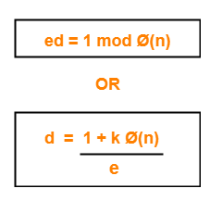
RSA Another Example
Two prime numbers, p=7, q=17
Calculate n = pq = 7 * 17 = 119
Φ(n) = (p-1)(q-1) = 96
Select e such that e is relatively prime to 96 and less than Φ(n), suppose e = 5
d=77 because 77*5= 385= 4*96+1
d=77 because (1.96-19.5=1 )mod 96
Public Key KU={5,119)
Private Key KR={77,119}
Say plaintext M = 19
C=19⁵(mod 119) = 66
Decryption: M=66⁷⁷(mod 119) = 19
Notes:
23

Slide 24
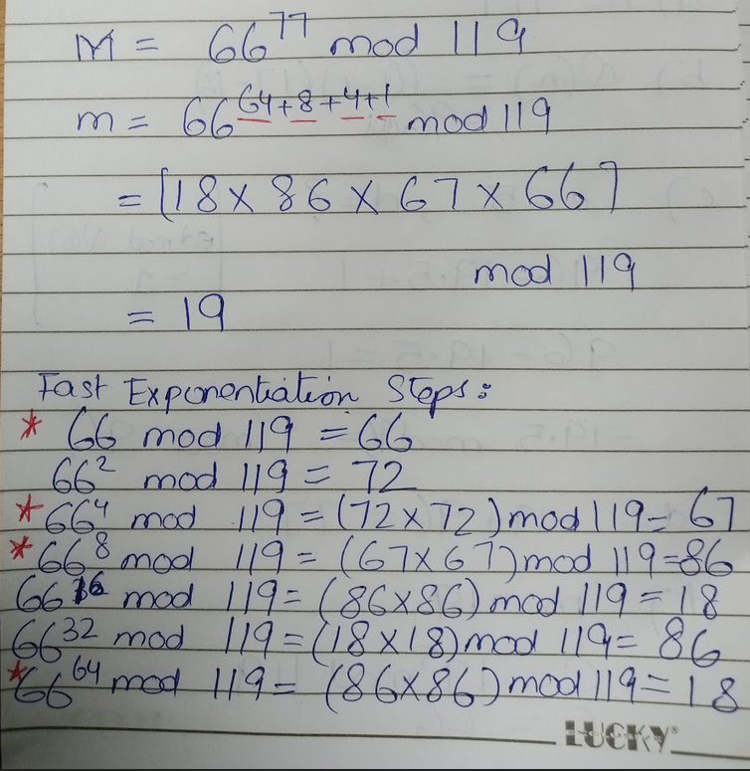
RSA Another Example
Notes:
24

Slide 25
PRACTICE
p = 7
q = 11
e = 17
d=?
M = 8
Encrypt
Decrypt

Slide 26
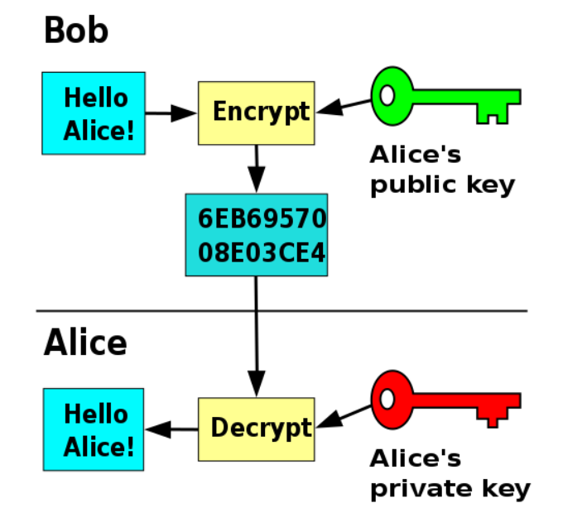
Encryption
Asymmetric Cryptography almost never useful for data encryption practically as (computationally heavy)!!!
Notes:
26

Slide 27
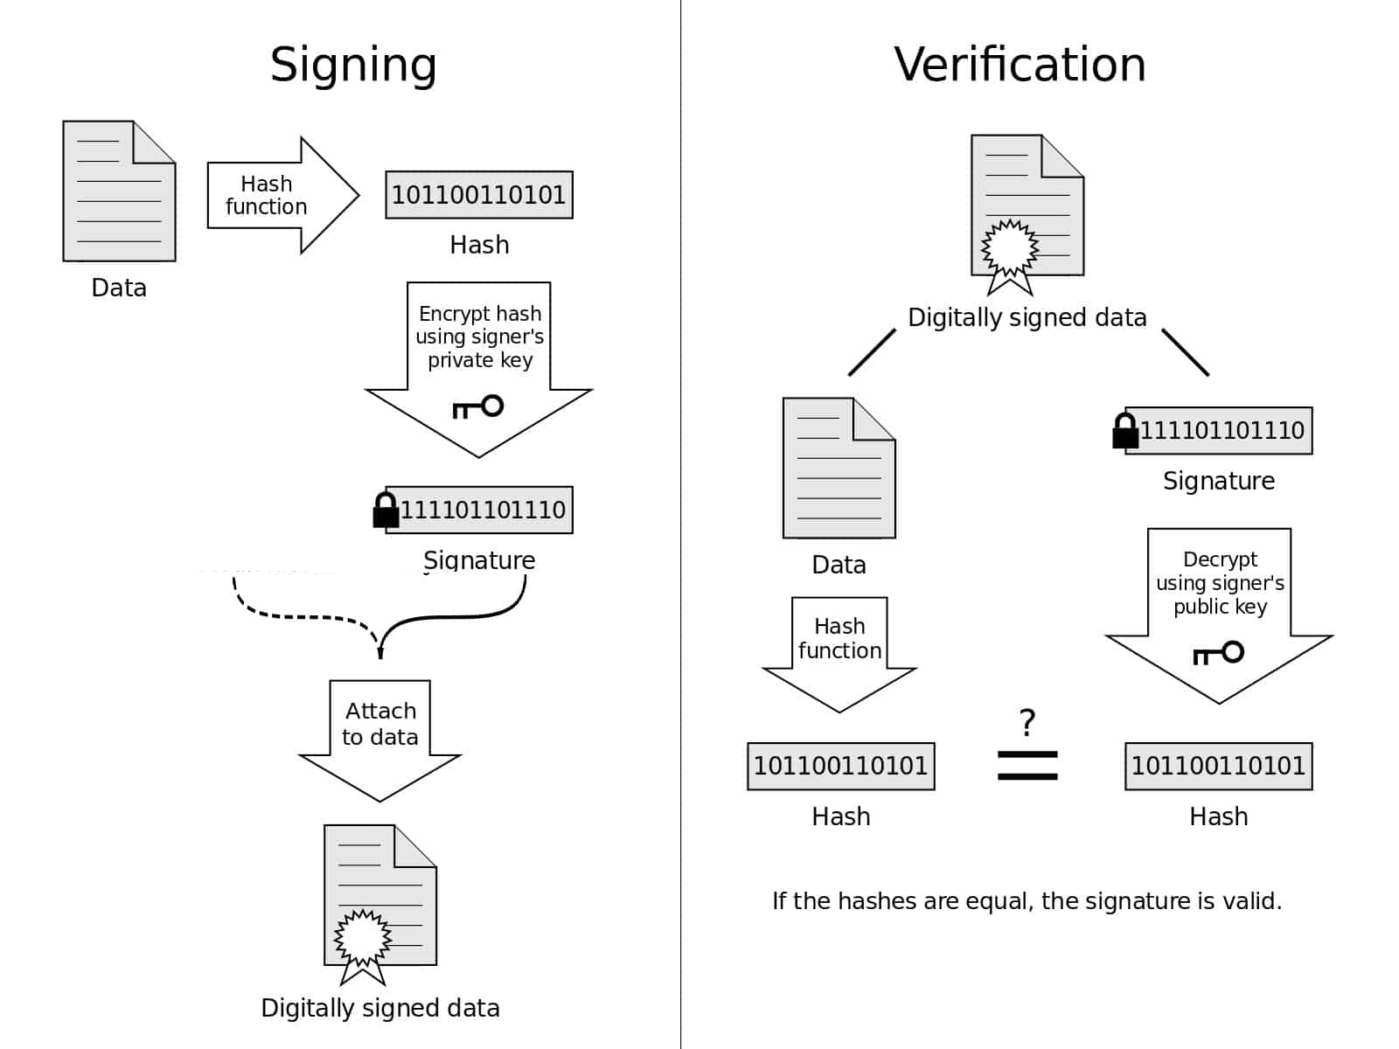
Digital Signature
Asymmetric Cryptography primarily used for signing hash of data.
Notes:
27

